Slide 1


Simon Bland
December 2024

Slide 2

Outline
Executive Summary
Introduction
Methodology
Results
Conclusion
Appendix

Slide 3
Executive Summary
Summary of methodologies
Data collected from SpaceX API and by webscraping Wikipedia
EDA performed using visualization and SQL queries, map-based analysis using Folium
Machine learning used to find best model and parameters for predicting success
Summary of all results
Early launches (low flight number) showed poor outcomes for all orbits and payloads.
Increasing trend of successful outcomes over time, over 80% success since 2018
Best landing outcomes achieved with mid-range payloads
Prediction of landing outcomes using decision tree classification gives best overall accuracy – 0.89

Slide 4
Introduction
Project background and context
SpaceX advertises Falcon 9 rocket launches on its website, with a cost of 62 million dollars; other providers cost upward of 165 million dollars each, much of the difference is because SpaceX can reuse the first stage.
Can we determine if the first stage will land?
If so, we can determine the cost of a launch. This information can be used to bid against SpaceX for a rocket launch.
What methods best predict first stage landing success?

Slide 5

Section 1

Slide 6
Methodology
Executive Summary
Data collection methodology:
Data collected from SpaceX public APIs and by webscraping Wikipedia
Perform data wrangling
Filtered to only include Falcon 9 launches
Missing data replaced by mean values
Perform exploratory data analysis (EDA) using visualization and SQL
Perform interactive visual analytics using Folium and Plotly Dash
Perform predictive analysis using classification models
Different classification model parameters evaluated using machine learning

Slide 7
Data Collection
Data sets were obtained via two methods:
SpaceX REST API
Webscraping Falcon9 and Falcon Heavy launches from Wikipedia

Slide 8
Data Collection – SpaceX API
SpaceX data collection process:
Extract data from launches API using Http GET request
Append data from other SpaceX APIs
Load into Pandas Dataframe
Filter to only include Falcon9 launches
Replace missing data with mean values
Append data
Rockets
Launch Pads
Payloads
Cores
Launches
Http GET request
JSON response
Pandas Dataframe
Filter & replace missing data
Jupyter notebook on GitHub

Slide 9
Data Collection - Scraping
Wikipedia webscraping process
Http request Wikipedia page
Create Beautiful Soup object from response
Extract relevant tables into dictionaries
Load into Pandas Dataframe
Wikipedia
Http GET request
Process using
Beautiful Soup
Dictionary objects
Jupyter notebook on GitHub
Pandas Dataframe

Slide 10
Data Wrangling
Preliminary data analysis using Pandas
Inspect for missing data
Examine attribute data types
Inspect outcome by orbit type
Visualize orbits
Create a classification variable to represent mission outcomes
Pandas Dataframe
Inspect data
Missing data
Data types
Outcome by orbit
Change categorical feature to numeric data
Simplify data
Jupyter notebook on GitHub

Slide 11
EDA with Data Visualization
Exploring Data
Flight number vs launch site
Payload mass vs launch site
Success rate of each orbit type
Flight number vs orbit type
Payload mass vs orbit type
Launch success yearly trend
Features Engineering
Dummy variables / change to float64
Pandas Dataframe
Plot Data
Take a high-level look at the data
Features Engineering
Make data easier to use
Jupyter notebook on GitHub

Slide 12
EDA with SQL
SQL queries include:
Unique launch site names
Total payload mass launched for NASA
Average payload mass carried by the F9 v1.1 booster
Date of the first successful ground pad landing
Boosters that have drone ship success in the 4000 – 6000 kg payload range
Total number of successful and failed flights
Booster versions that have carried the maximum payload mass
Failed landings in 2015
Count of different landing outcomes between 4/6/2010 and 3/20/2017
Jupyter notebook on GitHub

Slide 13
Build an Interactive Map with Folium
Added markers for NASA Johnson Space Center, individual launch sites
Understand proximity to equator, coastline, nearest major cities and local features such as roads and railways.
Added markers showing outcomes for each launch
Visualize geographical distribution of launch outcomes
Jupyter notebook on GitHub (quick preview)

Slide 14
Build a Dashboard with Plotly Dash
Added pie chart and scatter graphs for ALL launch sites and individual sites
Interactive visuals show overall success rate
Interactive visuals show success rate vs payload mass and booster type
Plotly Dash app on GitHub

Slide 15
Predictive Analysis (Classification)
Model development
Load Dataframe
Standardize data
Divide into training and test data
Use machine learning to perform grid search and identify best parameters
Logistic regression
Support vector machine
Decision tree classifier
K Nearest neighbor
Pandas Dataframe
Train/test Split
Machine Learning
Evaluation and score
Jupyter notebook on GitHub

Slide 16
Results
Exploratory data analysis results
No heavy launches are made from Vandenburg
For LEO, success is related to number of flights
Polar, LEO and ISS have better outcomes for heavy payloads
For GTO, outcomes are mixed
First successful landing in 2015
Increasing trend of successful outcomes over time
Average payload is 2535 kg
45596 Kg of payload carried for NASA

Slide 17
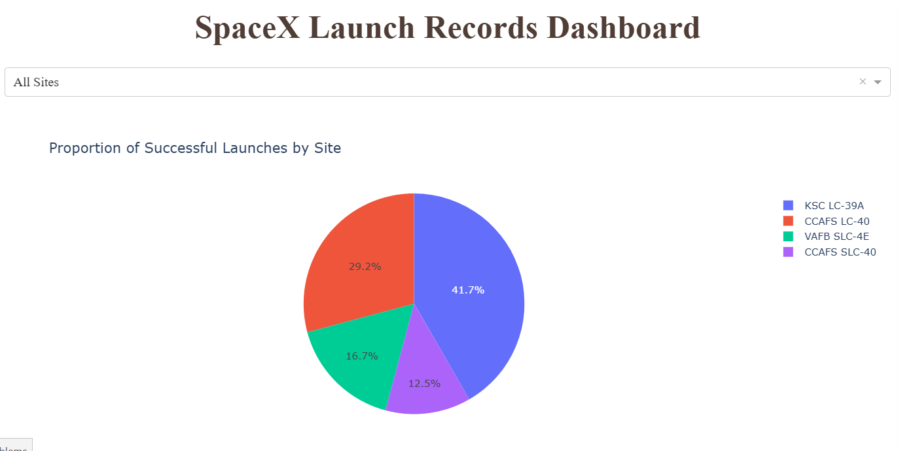
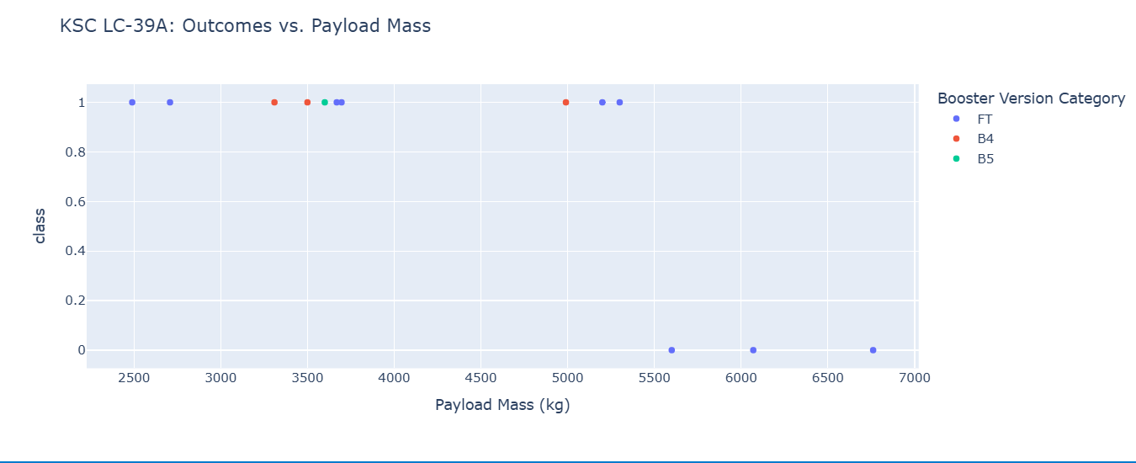
Results
Interactive analytics
Most successful outcomes/best success rate from KSC-39A

Slide 18
Results
Predictive analysis results
Only 18 test samples available with train test split of 0.2
Grid search used for better accuracy
Decision tree classification gives best overall accuracy – 0.89
Decision tree accuracy against test data – 0.94

Slide 19

Section 2

Slide 20
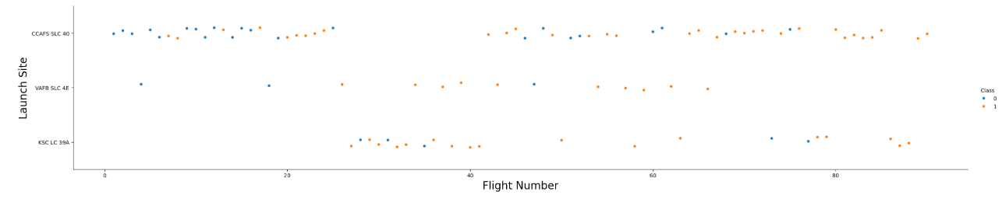
Flight Number vs. Launch Site
Findings
As flight number increases, the first stage landing is more likely to be successful
The lowest flight numbers had poor landing outcomes

Slide 21
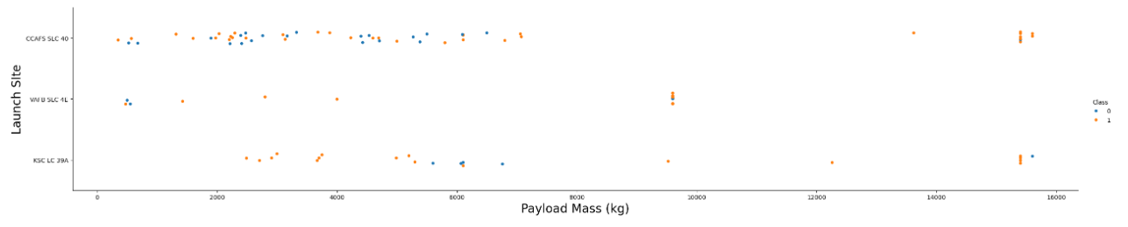
Payload vs. Launch Site
Findings
Payload mass does not appear to affect the success rate (likely that early trials were done with small payloads to reduce cost)
Heavier loads are launched from sites in Florida

Slide 22
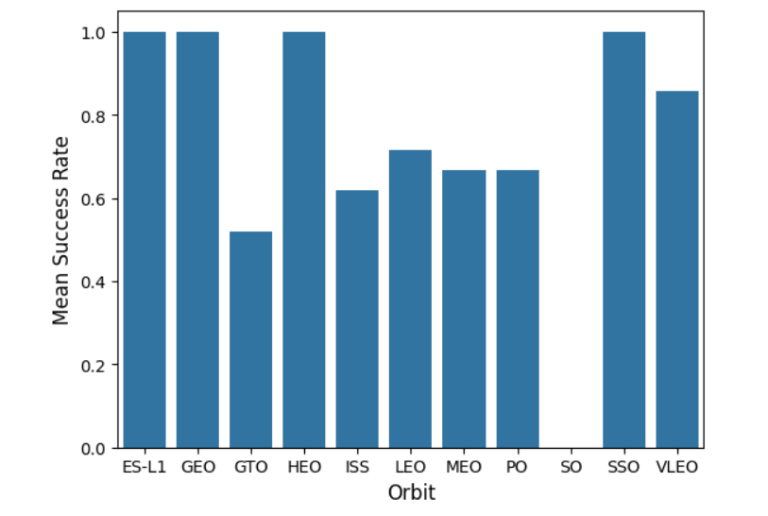
Success Rate vs. Orbit Type
Findings
ES-L1, GEO, HEO, SSO have 100% landing success rates
However, these represent only a small number of launches

Slide 23
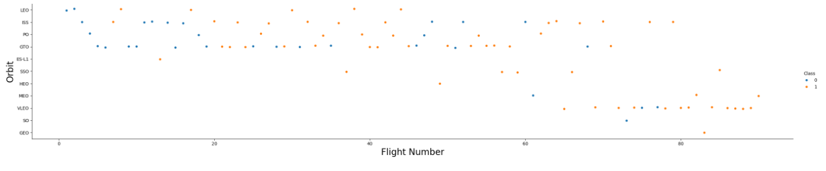
Flight Number vs. Orbit Type
Findings
All orbits with multiple launches have better outcomes with flight number
Landings for VLEO launches are successful throughout except for two failures
LEO has good success rate after initial failures

Slide 24
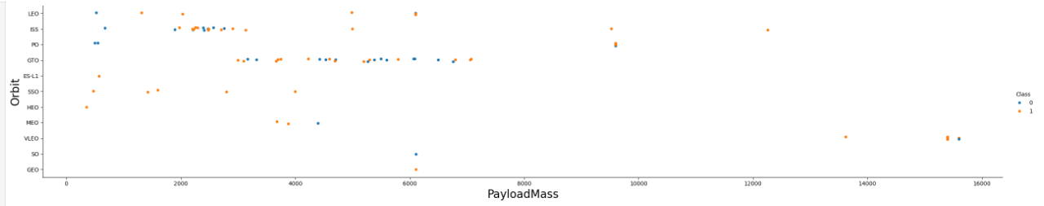
Payload vs. Orbit Type
Findings
The heaviest payloads are launched into the lowest orbits
Payload mass shows no relation to landing success

Slide 25
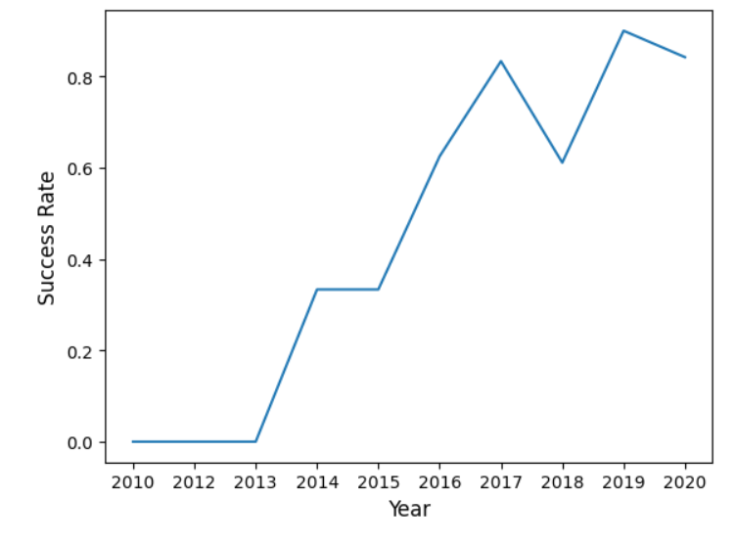
Landing Success Yearly Trend
Trend line shows clear improvement over time
No successes before 2013
50% success rate mark hit in 2016
80% success rate achieved in 2017
80%+ success rate from mid 2018 onwards

Slide 26
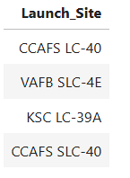
All Launch Site Names
Four unique launch sites are used
Vandenberg AFB is on California’s coast above Santa Barbara
Cape Canaveral launch complexes and Kennedy Space Center are co-located on Florida’s east coast, directly to the east of Orlando

Slide 27
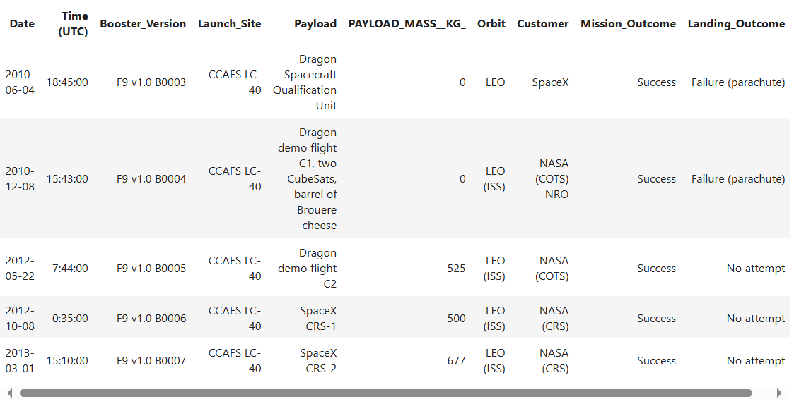
Launch Site Names Begin with 'CCA'
Sample of 5 launch records
From site names beginning with ‘CCA’
Launch sites are Cape Canaveral
Shows early flights
Some launches are demos and no landing attempt is made

Slide 28
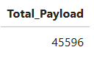
Total Payload Mass
Total payload carried for customer NASA
Over 45500 kg launched

Slide 29
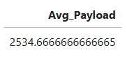
Average Payload Mass
Average payload mass launched
Across all F9 v1.1 launches, mean payload mass is 2534.7 kg

Slide 30
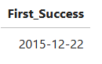
First Successful Ground Landing Date
First successful landing on a ground pad
Achieved on December 22, 2015
Successful landings prior to this were done at sea

Slide 31
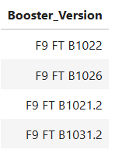
Successful Drone Ship Landing with Payload between 4000 and 6000
First stage boosters w/successful landing on drone ship
Where 4000 kg < payload mass < 6000 kg
F9 FT booster is used for drone ship landings in this payload range

Slide 32
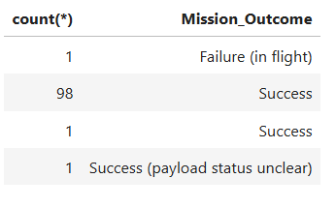
Total Number of Successful and Failure Mission Outcomes
Total successful and failure mission outcomes
Refers to the success of the overall mission, not first stage landing success
Overall success rate > 99%

Slide 33
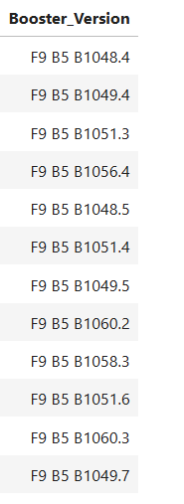
Boosters Carried Maximum Payload
Boosters carrying maximum payload mass
Only the F9 B5 booster is used for maximum payload launches

Slide 34
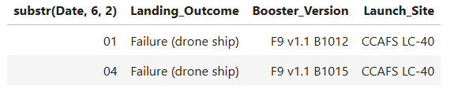
2015 Launch Records
Failed landing outcomes on a drone ship in 2015
Failures occurred in January and April
Both launches were from Cape Canaveral

Slide 35
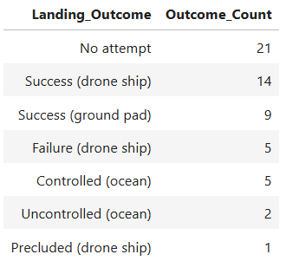
Rank Landing Outcomes Between 2010-06-04 and 2017-03-20
Ranked count of landing outcomes
Between June 4, 2010, and March 20, 2017
High (100%) success rate for attempted ground landings
Good success rate (74%) for attempted drone ship landings
On 21 occasions (37%), no attempt was made to land the first stage booster

Slide 36

Section 3

Slide 37
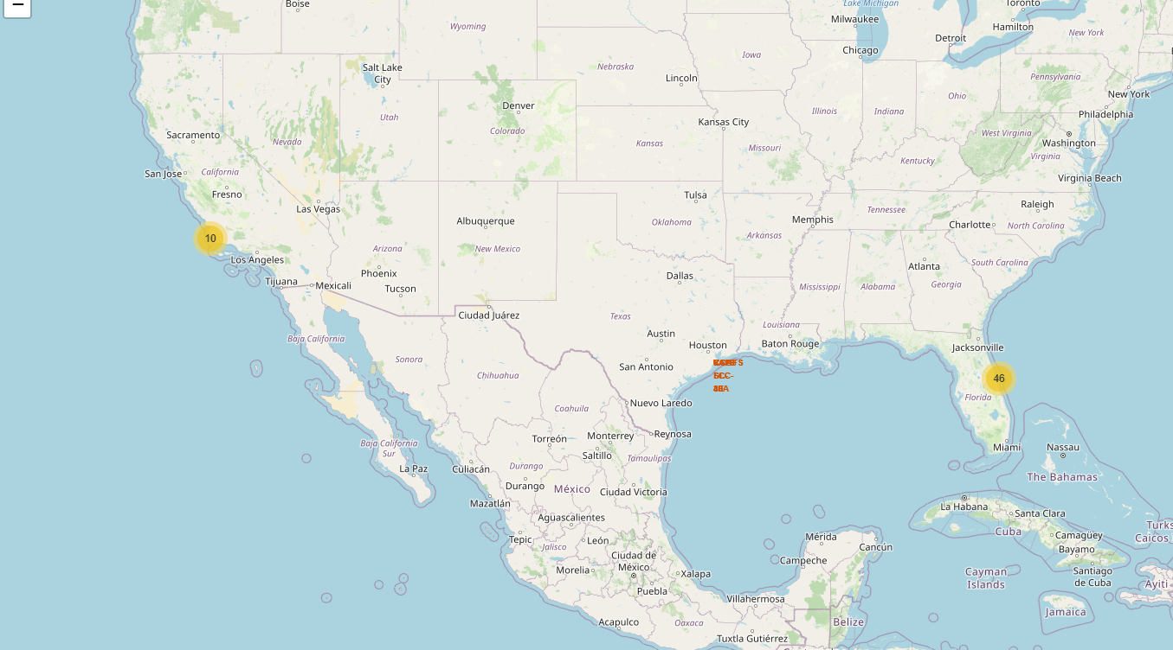
NASA JSC and Launch Site Locations
Findings
NASA Johnson Space Center is in Houston
SpaceX launches from sites on the west and east coasts
All locations are in the southern-most latitudes of the country

Slide 38
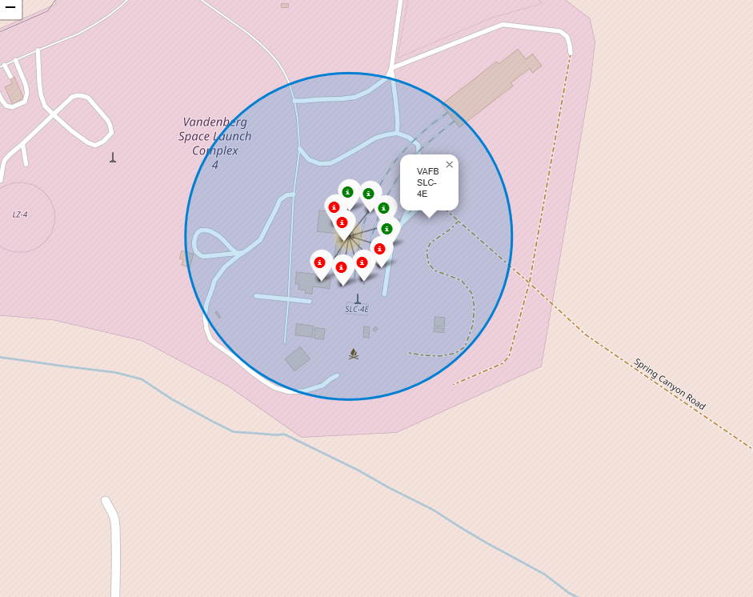
Landing Outcomes at VAFB
Findings
Successful (green) and failed (red) landings are overlaid at the launch site location

Slide 39
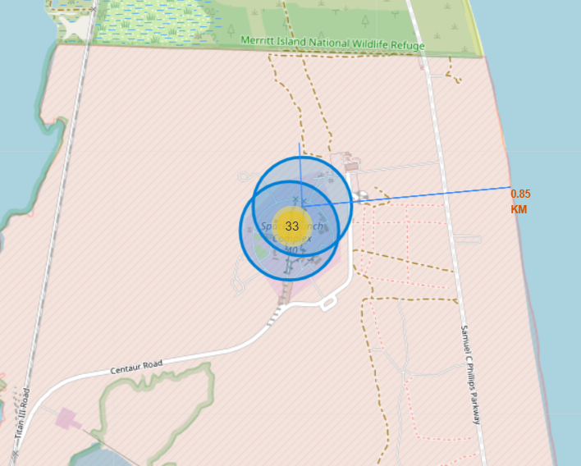
Proximity of Launch Site to Coast
Findings
CCAFS SLC-40 is 0.85km from the coast
All launch sites are served by rail connections and roads
All launch sites are proximate to interstate highways
All launch sites are situated away from major cities
FL launch sites are to the east of cities
CA launch sites are west of desert areas

Slide 40

Section 4

Slide 41
SpaceX Landings
Findings
More successful landings were made after launching from Kennedy space center than from any other site

Slide 42
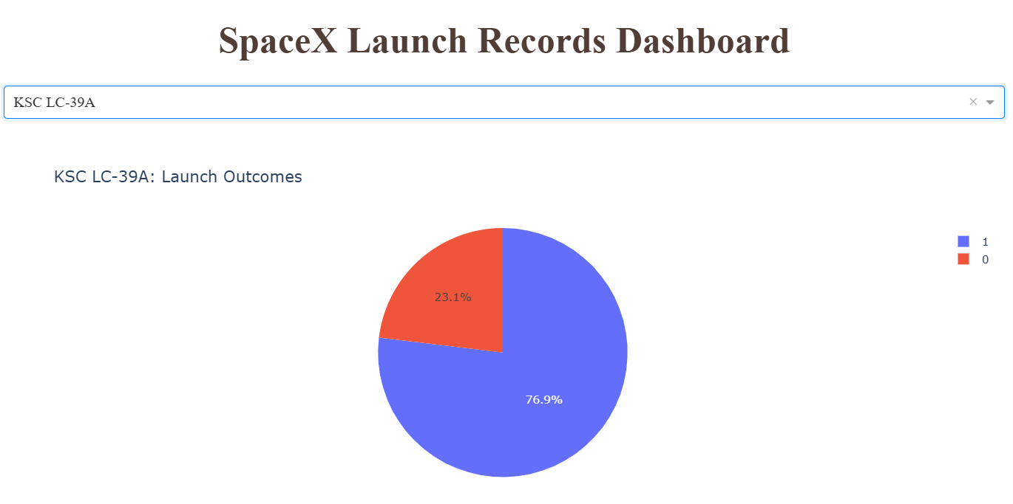
Site With Best Landing Outcomes
Findings
Kennedy space center also has the highest proportion of successful landings

Slide 43
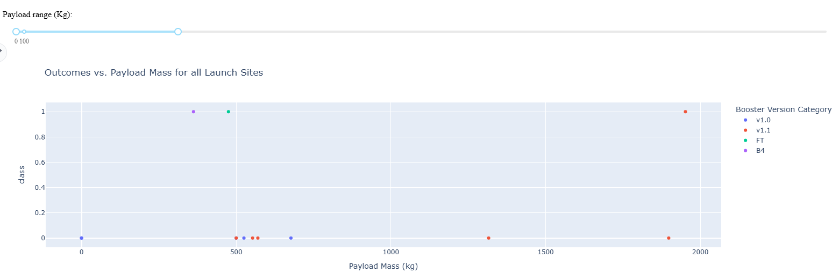
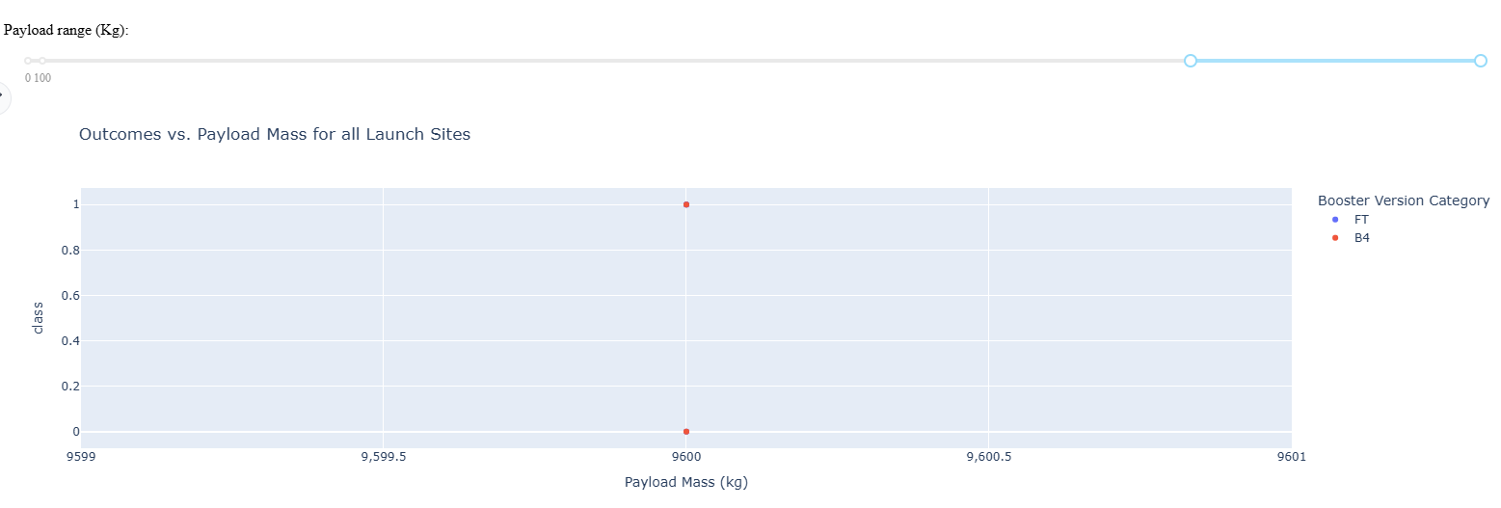
Payload vs Launch Outcome (All Sites)
Findings
Low mass launches with v1.0 and v1.1 boosters have low success rate
High mass launches with B4 booster have mixed success rate
Best outcomes occur with mid-payload mass range (not shown)

Slide 44

Section 5

Slide 45
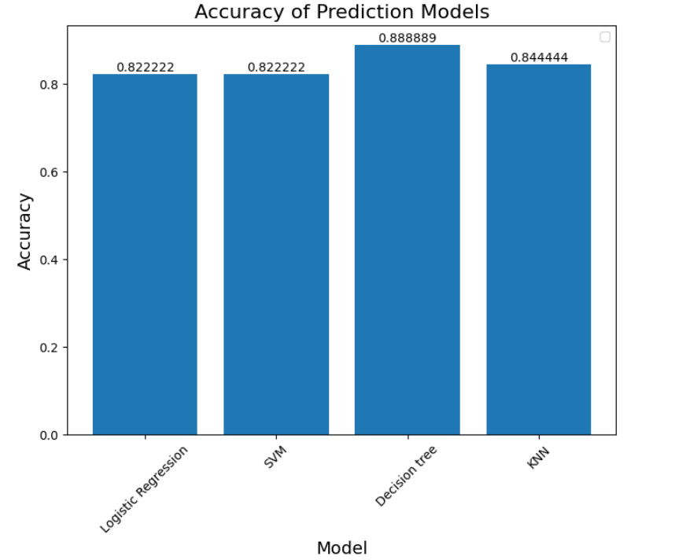
Classification Accuracy
Findings
All models perform well
Decision Tree model:
Best accuracy (0.89)
Best R2 score against test data (0.94)

Slide 46
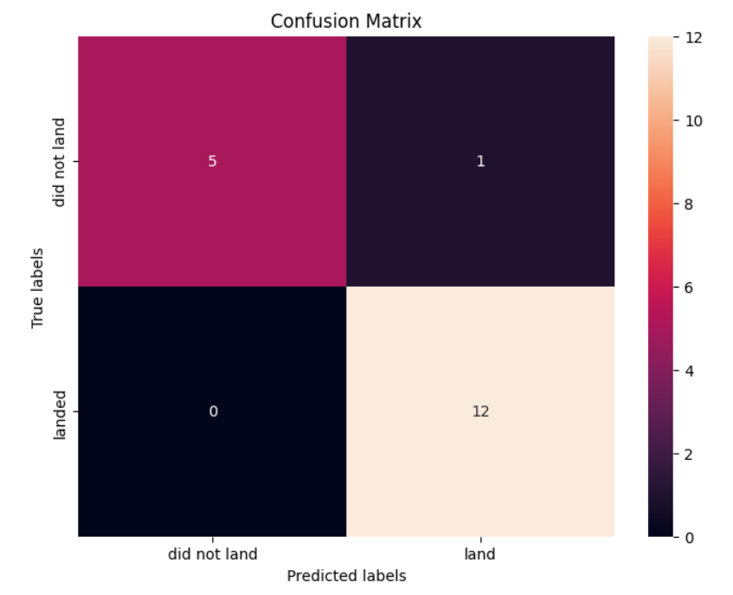
Confusion Matrix
Findings
Decision Tree model
One false positive for successful landing
No false negatives

Slide 47
Conclusions
Findings
Early launches (low flight number) showed poor outcomes for all orbits and payloads.
Increasing trend of successful outcomes over time, over 80% success since 2018
Best landing outcomes achieved with mid-range payloads
Largest payload masses are launched into low orbits
Average payload is 2535 kg
Small data size (<110 launches) makes grid search and machine learning important tools for predicting successful landing outcomes
Prediction of landing outcomes using decision tree classification gives best overall accuracy – 0.89

Slide 48
Appendix
GitHub repository containing all notebooks, code, graphics and data:
IBM Data Science Capstone Project
SpaceX Wikipedia:
SpaceX – Wikipedia
Falcon9 launches (webscraped data):
List of Falcon 9 and Falcon Heavy launches - Wikipedia

Slide 49


